Slide 1

Machine Learning Task
Twitter Predicts The Dialect Given The Tweets
Dialect Prediction.

Slide 2

Table of contents
Introduction
Tools && Methodology
Implementation process
Demo
Q/A

Slide 3

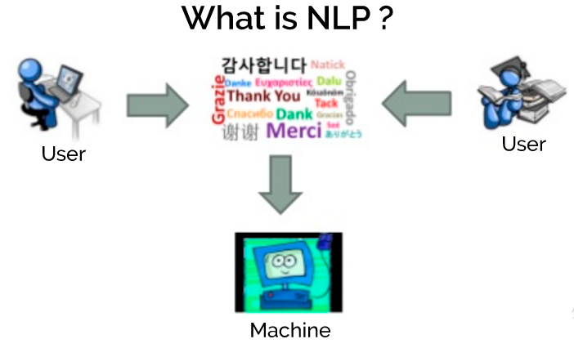
…INTRODUCTION
Natural Language processing (NLP)
What Natural Language Processing (NLP) is using for?

Slide 4

Implementation:
Tweet Downloader
Preprocessing
Remove Stopwords
Remove Punctuations
Removing URLs
Removing Stop words
Remove White spaces
Removal of emojis
Removal of HTML tags
Most Common Words
Removal of Frequent words

Slide 5
Tools:
Python
NLTK Package
Flask API
Methodology:
Naive Bayes
SVM
RNN

Slide 6
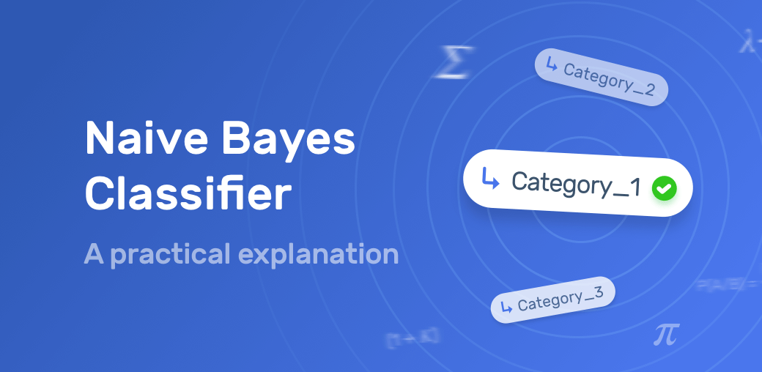
Naïve Base:
Coding…
What is Naive Bayes Algorithm?
- Easy to build
- Works like :

Slide 7
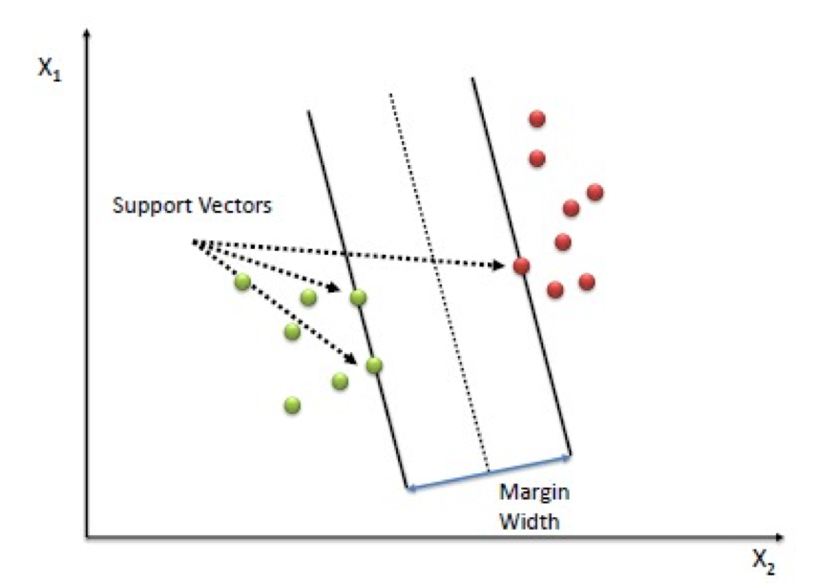
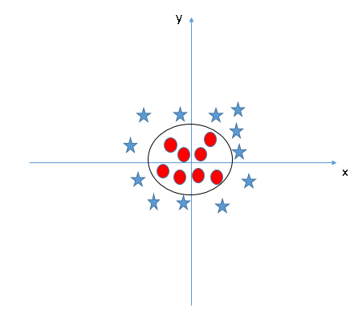
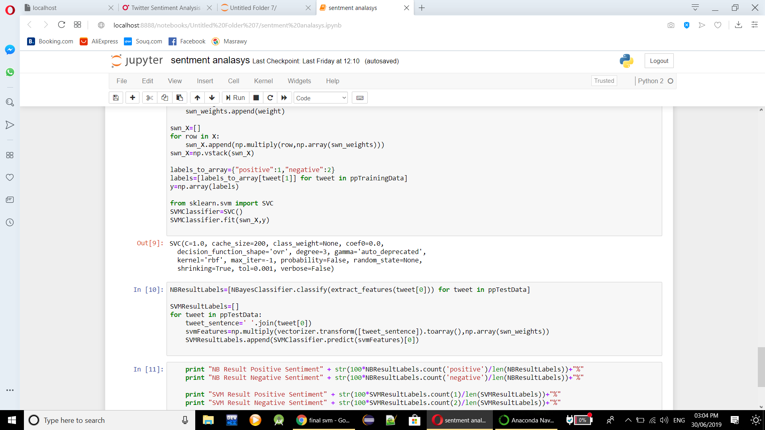
Support Vector Machine :
What is Support Vector Machine (SVM)?
kernel trick
Why we use SVM in our Project

Slide 8
Thank You Q/A

